Slide 1
Kaiser Permanente
Preventive Healthcare Fitness Application
HealthY
Product Owner: Diana Vile
© 2023 Udacity. All rights reserved.

Slide 2


Background
Why Are We Here?
6 in 10 US Adults live with a chronic disease & 4 in 10 US Adults have more than one chronic disease[1].
© 2019 Udacity. All rights reserved.

Slide 3




Background
Why Are We Here?
Potential causes of Chronic diseases:
Prevent chronic diseases with “HealthY”
(Kaiser Permanente app)
Potential causes:
Poor nutrition | Excessive alcohol use
Physical inactivity | Tobacco use & exposure to secondhand smoke.
9 in 10 US Adults consume too much sodium [2].
1 in 5 US Adults
deaths between 20-49 years
of alcohol abuse [4].
90%
20%
1 in 4 US Adults
who don’t smoke [5]. are exposed to
second-hand smoke [6].
1 in 2 US Adults gets insufficient physical activity[3].
50%
25%
© 2019 Udacity. All rights reserved.

Slide 4
Business Case
© 2019 Udacity. All rights reserved.
Notes:
[ALL PARTICIPATION]

Slide 5
Initial Focus
Where are we starting?
We live in a global, health-obsessed world. Yet not all world citizens are as active, as society demand. In fact, in daily life, many of us are physically inactive. This is causing severe health conditions and tremendous Health Costs that could be prevented.
In 2018, the World Health Assembly agreed on a global target to reduce physical inactivity by 15% by 2030.[7] Worldwide, 1 in 4 adults (age 18+ years), and 3 in 4 adolescents (age 11-17years) do not currently meet the global recommendations for physical activity set by the World Health Organization (WHO) [8, page 6]
Take the US as an example: Bad lifestyle habits such as a sedentary lifestyle, poor nutrition, alcohol abuse and smoking often lead to chronic diseases and premature death.
“The US spend $4.1 Trillion in Annual Health Care Costs [9] on chronic disability such as diabetes, depression, high blood pressure and heart diseases care and premature death". 90% of these healthcare costs are for chronic diseases [10] that could be saved with preventive healthcare (by creating healthier lifestyle habits).
Prevent chronic diseases with Kaiser Permanente preventive health care Fitness Application “HealthY”: “Improve your health one step at a time”.
© 2019 Udacity. All rights reserved.

Slide 6
Initial Focus-Risk Factors
Where are we starting?
Physical inactivity is one of the leading risk factors for premature death: Insufficiently active people have a
20% to 30% increased risk of death compared to sufficiently active people [3].
Risk Factors | Healthcare costs per year | People affected per year
Cigarette Smoking | $240 billion*[10] | >16 million (=25% adults)
Physical inactivity | $117 billion*[10] | 5.7 million 10% (Age 65+)
Excessive alcohol | $249 billion *[10, 2010]
Poor Nutrition | $173 billion*[11]
*[10] Health and Economic Costs of Chronic Diseases | CDC
*[11] Poor Nutrition | CDC
© 2019 Udacity. All rights reserved.

Slide 7
Initial Focus-Chronic Diseases
Where are we starting?
Chronic diseases are the leading cause of premature death and disability.
A combination of physical inactivity, poor nutrition, alcohol abuse and smoking often leads to chronic diseases.[12]
Preventable Chronic diseases | Healthcare costs per year | People affected per year
Heart disease & Stroke | $216 billion & $147 billion Lost productivity
Cancer | $240 billion*[10] | 1.7 million
Diabetes, Pre Diabetes | $327 billion | 37 million (D), 96 million (preD)
Obesity | $173 billion | 42% adults, 20% children, 25% adolescents
*[10] In 2030, Health and Economic Costs of Chronic Diseases | CDC
© 2019 Udacity. All rights reserved.

Slide 8
Initial Focus-Chronic Diseases
Where are we starting?
90% of all of these chronic diseases can be prevented by adopting a healthier lifestyle [12]:
Preventable Chronic diseases | Healthcare costs per year | People affected per year
Arthritis | $303.5 billion*[10, 2013] | 58.5 million (=25% adults)
Alzheimer | $305 billion*[10, 2020] | 5.7 million 10% (Age 65+)
Epilepsy | $8.6 billion*[10, 2016] | 3 million adults, 470,000(0-20yrs)
Tooth decay | $45 billion | 25% adults, 1 in 6 children
*[10] Health and Economic Costs of Chronic Diseases | CDC)
© 2019 Udacity. All rights reserved.

Slide 9
Opportunity
Where are we starting?
Calculations:
Adult Population 2022: Total population(100%) - Child population (22.2%)= 77.8% * 333.287,557 Million=259.3M adults.
Adult Population with Chronic Disease 2022: Total adult population x adult population with chronic disease (6 in 10=60%)
60% * 259.3 Million=156.6 Million adults in the US.
Marketing Population US Market in 2022 | Total | %
Child Population (0-18yrs) | 73,989.838 million children (=73.9M children). | 22.2%
Adult Population (0-(18+yrs) | 259.297.719 million adults (=259.3M adults). | 77.8%
Total Population | 333.287,557 million people [13]. (=333.2 M people in the US). | 100%
Adult Population with chronic disease | 155.578.631 million adults (=155.6 M adults in the US) | 60%
© 2019 Udacity. All rights reserved.

Slide 10
Opportunity
Where are we starting?
“90% of annual healthcare costs destinated to chronic diseases can be reduced with preventive healthcare”
Calculations:
Adult Population 2022: 77.8% * 333.287,557 Million=259.3M adults.
Adults with Chronic disease in the US: 60% * 259.3 Million= 155.578.631M adults have a chronic disease in the US.
Annual Healthcare Costs for Adults with Chronic disease= Total Annual Healthcare Costs/ (adults chronic disease/total population): $4.1Trillion a year/ (155.578.631M/ 333.287,557M)= $1.9 Trillion a year.
Total preventable Annual Healthcare costs spend on US adults: 90% * $1.9 trillion= $1,72 Trillion a year.
Total Addressable Market (TAM)- US market | Total amount | %
Annual Healthcare Costs Spend | $4.1 Trillion a year | 100% (children & adults).
Adult population 2022 | 259.3M adults | 77.8%
Adult population with chronic disease | 155.578.631M adults | 60%
Annual Healthcare Costs Adults with Chronic disease | $1.9 Trillion a year.
Total Preventable Annual Healthcare Cost Spend | $1,72 Trillion a year. | 90%
© 2019 Udacity. All rights reserved.

Slide 11
Opportunity
BUSINESS GOALS:
Promote a healthier lifestyle via “HealthY” add-on Modules on existing preventive health fitness app to:
1- Increase health awareness among US Adults
2- Prevent chronic diseases among US Adults
3- Reduce preventable annual healthcare costs
Revenue stream:
Freemium existing health app (=free Health app with advertisements)
Paid Subscription- HealthY (=Premium, Paid Modules to be built without ads, incl. healthcare professionals.)
What’s the problem?
© 2019 Udacity. All rights reserved.

Slide 12
Proposal
What’s Our Solution?
HealthY: “Improve your health one step at a time”.
Kaiser Permanente is NOT just another fitness app. It is an all-in-one healthcare app that encourages American adults to take care of their health one step at a time. We do this by creating additional modules “healthY” to make the existing Healthcare app Kaiser Permanente actionable and a true all-in-one Health app platform :
 | Module | Theme | Topics | Revenue stream
EXISTING | Module 0: Healthcare | Healthcare NEW: Add educational Health tips | quit smoking, medical screenings, toothcare, family history of diseases. | Free
NEW | Module 1: Sport & Nutrition | HealthY module1: Sport & Nutrition | Regular physical activity, eat healthy, avoid too much alcohol | Paid Subscription
FUTURE BUILD | Module 2: Self-care | HealthY module2: Self-care | Sleep & relaxation, create healthy lifestyle habits, and make healthier lifestyle choices. | Paid Subscription
© 2019 Udacity. All rights reserved.

Slide 13

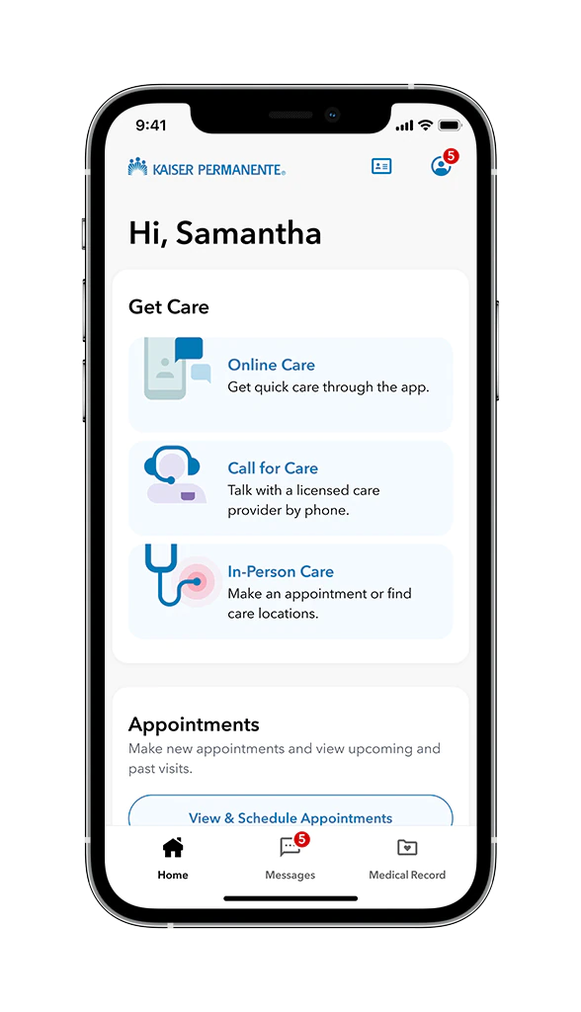
Module 0: Existing App-Healthcare
Features Kaiser Permanente app- manage your health- all in one place.
Simple and secure
Email your doctor’s office or Member Services with nonurgent questions
Schedule, view, and cancel routine appointments and see information about past visits
Fill or refill most prescriptions, check the status of a prescription order, and see a list of all your medications
View your medical history, including allergies and immunizations, ongoing health conditions, and most lab test results
Choose a doctor by browsing our online doctor profiles
Find facilities and pharmacies near you
Get care in a way that works for you — online, by phone, or in person
Access your digital membership card to check in for appointments, pick up prescriptions
Get personalized reminders and health information on availability
HEALTH-FEATURE1&2: Add Educational Tips from Health Pros & In-app Feedback from Customers in real-time.
What’s Our Solution?
© 2023 Udacity. All rights reserved.

Slide 14
Proposal-Module1 “HealthY” Sport& Nutrition
Features Kaiser Permanente app- manage your health- all in one place.s
Simple and secure
NUTRITION-FEATURE1: Browse food suggestions in a comprehensive food database with healthy recipes and non-alcohol drinks.
NUTRITION-FEATURE2: Set food goals & log food entries on a daily basis.
NUTRITION-FEATURE3: Email Nutrition Health specialist in Chat for questions regarding healthy choices.
NUTRITION-FEATURE4: Schedule, view, and cancel routine appointments and see information about past visits
SPORT-FEATURE1: Find gym facilities near you
SPORT-FEATURE2: Schedule your workout routines
SPORT-FEATURE3: Start a 5 min workout
SPORT& NUTRITION-FEATURE4: Get a REWARD* after a workout (*Get a discount on meal plans, nutrition check ups, sports clothes, gym classes, physiotherapy, or personal trainer).
What’s Our Solution?
© 2023 Udacity. All rights reserved.

Slide 15
Future-Module2 “HealthY” Self-care
Features Kaiser Permanente app- manage your health- all in one place.
Simple and secure
SELF-CARE-FEATURE1: Set your self-care goals: stop smoking, become physically active, eath healthy, get energized, think positive,
SELF-CARE-FEATURE2: Create and schedule your morning and evening routines (relaxation & getting enough sleep)
SELF-CARE-FEATURE3: Create healthy lifestyle habits: stop smoking, become physically active, eath healthy, get energized, think positive,
SELF-CARE-FEATURE4: Schedule your self-care routines
SELF-CARE-FEATURE5: Start a 5 min routine (morning routine, evening routine,
SELF-CARE-FEATURE6: Log your efforts in a daily habit tracker
SELF-CARE-FEATURE7: Get your Reward: Gain points to treat yourself to a sauna, massage, flowers, healthy dinner, coffee with a friend, and walk in the park, among others.
What’s Our Solution?
© 2023 Udacity. All rights reserved.

Slide 16
Return On Investment
What can we do?
Kaiser Permanente KP
Downloads: 100M members Kaiser Permanente App*[14]
Users: 12.6M [15, 16, 17].
Paid Subscription plan: 50$ per year.
Estimated costs: $280,000.
*[14] Kaiser Permanente App I Google App Store.
*[15] Kaiser Permanente App I Fierce Healthcare. 9 million users in 2012
*[16] Kaiser Permanente App I FastCompany. 12 million users in 2022.
*[17] Kaiser Permanente App I Statista. 12.6 million users in 2022.
© 2019 Udacity. All rights reserved.

Slide 17
Return On Investment
What can we do?
Kaiser Permanente KP
Estimated Sign-up rate for paid subscription plan: 5% in the first year.
Paid subscription users for the first year: 5% * 12M= 600.000 paid subscription users in the first year.
Estimated revenue (amount gained): 5% x 12M x $50= $30,000.000
Return On Investment (ROI): (estimated revenue-estimated costs/estimated costs)=
$30,000.000 -$280,000/$280,000= $30,000.000= 106,14.
© 2019 Udacity. All rights reserved.

Slide 18
Measurement
How will we know if we’re successful?
BUSINESS
The most important KPI metrics are:
KPI 1: Sign-up rate for paid customers: 5% of new customers in the first year.
KPI 2: Usage rate of customers: 10% of existing customers in the first year.
© 2019 Udacity. All rights reserved.

Slide 19
Measurement
How will we know if we’re successful?
Other important metrics might be:
Quality
Download +10% for free customers
Customer recommendation on Google Play Store and Apple Play Store (App Store Rating, nr of App downloads)
In-app Rating: Trainer rating Doctor rating, Nutritionist rating.
Business Growth
Customer growth rate: 8% increase from historical growth in year two.
App Development
On-time delivery of features, the loading time of the app, and Average time of release on Google Play Store (Android) & Apple Play Store (Ios).
© 2019 Udacity. All rights reserved.

Slide 20
Competitors
© 2019 Udacity. All rights reserved.
Notes:
[ALL PARTICIPATION]

Slide 21
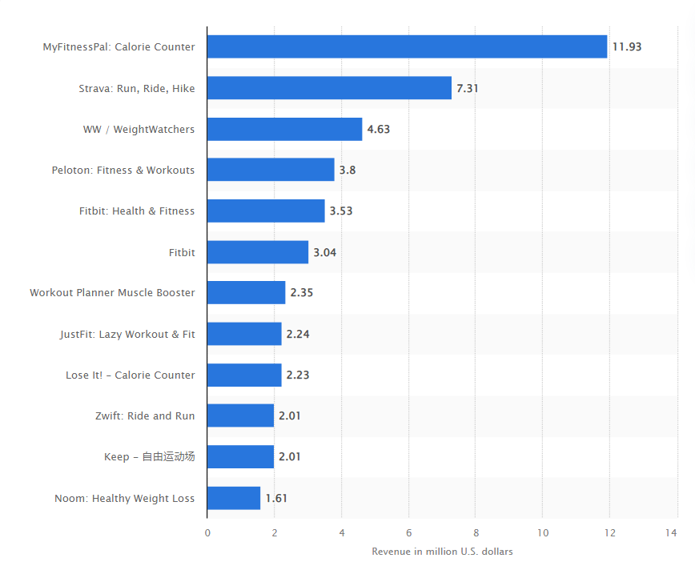
Fitness app competitors
Leading fitness and sport apps worldwide in March 2023, by revenue(in million U.S. dollars) [18]
[18] Top fitness and sport apps by revenue 2023 | Statista
© 2019 Udacity. All rights reserved.

Slide 22

MyFitnesspal: caloriecounter
Acquired by UnderArmour in 2015, sold to Francisco Partners 20200
MyFitnessPal [19] is a weight loss and fitness app. It helps nearly 1 million members reach their nutrition and fitness goals every year. In March 2023, MyFitnessPal was the leading fitness and sports mobile app, generating in-app revenues of $11.93 million[[18].
Target audience: People that are looking to take back control of their health and fitness
Benefits
Free calorie counter app Optional features on subscription
Easy to use
Large database of foods and exercises
Aligned with UnderArmour (incl. shopping deals)
Features
Calories tracker
Calorie counter to log food
App food database with 24 million foods
Short workout videos for daily workout routine
Workout timer Track calories burned
[18] Leading fitness and sport apps worldwide in March 2023, by revenue Statista
[19] MyFitnessPal Revenue and User Statistics (2022) (mobilemarketingreads.com
© 2019 Udacity. All rights reserved.

Slide 23

Strava: Run, ride, hike
Strava is the largest sports community in the world. It connects over 100 million runners, cyclists, hikers, walkers and other active people in 195 countries through the sports they love on our mobile app and website In March 2023, Strava ranked second, with $7.31 million in combined revenues via Google Play and Apple App Store [18].
Target audience: Every effort counts on Strava. People who want to become athletes and stay active.
Benefits
Including routes and trails
Add safety contacts
In collaborating with existing Sport clubs
The social network for athletes
Features
Track & Analyse sport activities
Measure performance
Share & Connect with friend & athletes
Explore new routes & Compete with community
Realtime GPS
[18] Leading fitness and sport apps worldwide in March 2023, by revenue Statista
© 2023 Udacity. All rights reserved.

Slide 24
Our Advantages
“HealthY: Improve your health one step at a time.”
The Preventive Healthcare Fitness App Kaiser Permanente [20] is more than just another fitness app. It is an all-in-one health app platform for Health, Sports & Nutrition & Self-care for both Ios and Android devices. Our paid subscription add-on “HealtY” modules extend the knowledge and expertise of the existing app. It provides health features that no other fitness app has and goes beyond just nutrition and sport advice. Sports& Nutrition and Self-care modules are part of an overall healthcare app with full medical history data, appointment bookings, preventive healthcare, and healthcare tips from health professionals (doctors, pharmacy, personal trainer, and nutrition).
Why are we better?
Benefits
Improve health, sport & nutrition and self-care
Reward active users via gamification
Increase physical activity
Create healthy lifestyle habits
Prevent chronic diseases
Maintain a healthy body weight
Reduce preventable healthcare expenses.
Features
Preventive health care
Personalized coaching program
Book an appointment with Personal Nutritionist
Health Tips (food, fitness & self-care).
Aligned with a health service provider.
Reward system.
Immediate results in customer health.
Expertise and trust in our recommendations on Google Store App and Apple Store App.
© 2019 Udacity. All rights reserved.

Slide 25
Roadmap and Vision
© 2019 Udacity. All rights reserved.
Notes:
[ALL PARTICIPATION]

Slide 26
Roadmap Pillars
Where do we go from here?
“With every life we touch, we’re contributing to the growth of a healthier, more vibrant world.”
Kaiser Permanente, 2023.
Kaiser Permanente App is the all-in-one health app platform for Health, Sports & Nutrition & self-care. With the HealthY modules, Kaiser Permanente wants to become the leader in high-quality healthcare.
We do this by adding:
Module 0 (FREE): HEALTHCARE- add educational tips from healthcare pros to improve health conditions.
Module 1 (PAID): SPORT & NUTRITION- to control weight, combat health conditions & diseases & boost energy.
FUTURE Module 2 (PAID): SELF-CARE- to gain healthy lifestyle habits and routines and improve mood.
© 2019 Udacity. All rights reserved.

Slide 27
Theme 1: Healthcare tips and Tricks
Learn why chronic health conditions & diseases occur and how to prevent them via educational content from health Pros.
HEALTH-FEATURE1: Add Educational Tips from Health Pros
Add a database of educational tips from health professionals on
Health conditions
Chronic diseases
Causes of chronic diseases
How to reduce caused with health, sport & nutrition & self-care
HEALTH-FEATURE2: Allow customer additions and feedback in real-time
Add customer comments and feedback on health education tips in real-time
© 2019 Udacity. All rights reserved.

Slide 28
Theme 2: HealthY module1: Sport & Nutrition
Put in practice- Create a healthier version of yourself one step at a time
NUTRITION-FEATURE1: Browse healthy food suggestions in the database
Browse food suggestions in a comprehensive food database with healthy recipes and non-alcohol drinks.
NUTRITION-FEATURE2: Set food goals & log food entries daily.
Create food goals and create daily food log entries to discuss with the Nutrition health specialist.
NUTRITION-FEATURE3: Email the Nutrition Health Specialist
Chat in real-time with available Nutrition Health specialists for questions regarding healthy choices.
SPORT-FEATURE1: Find gym facilities near you
Connect Google Maps connection to find gym facilities near you.
SPORT-FEATURE2: Schedule your workout routines
Add a calendar feature to add and schedule existing workout routines from a sport & exercise database.
SPORT-FEATURE3: Start a 5 min workout
Upload all Videos to YouTube (unlisted) to start the workout video directly from the app.
© 2019 Udacity. All rights reserved.

Slide 29
3: Reward system
Get rewarded- small rewards to make people come back on a daily basis
HEALTH-FEATURE3: NOW
Create easy-to-track HEALTH & SPORT & NUTRITION goals
Provide points
Get a reward: collect points to get a free healthcare check-up with a specialist.
Get access to premium features on completing your goals.
SPORT& NUTRITION-FEATURE4:NOW
Create easy-to-track HEALTH & SPORT & NUTRITION goals
Exercise 4 times a day 5 min work out, 5 times a week.
Provide points when meeting goals.
Get a reward: discount for meal plans, nutrition tips, sports clothes, gym classes, physiotherapy, or personal trainer).
© 2019 Udacity. All rights reserved.

Slide 30
Where do we go from here?
Widening the scope
In order to let “Kaiser Permanente App” with paid subscription modules “HealtY” become the
“all-in-one health app platform for Health, Sports & Nutrition & Self-care”, in the near future, we will focus on:
Build Module 2- SELF-CARE module (see Future slide 15).
Add premium features: Personal consulting with doctors, nutrition, and fitness trainers).
Create partnerships with gyms, sports brands, health professionals and health-& self-care-related companies.
Create a growth marketing plan to grow the customer base of paid subscriptions.
© 2019 Udacity. All rights reserved.

Slide 31
References
© 2019 Udacity. All rights reserved.
Notes:
[ALL PARTICIPATION]

Slide 32
References
for further reading
[1] About Chronic Diseases | CDC. Accessed 10/05/23. https://www.cdc.gov/chronicdisease/about/index.htm
[2] Factsheets Nutrition| CDC. Accessed 10/05/23. https://www.cdc.gov/chronicdisease/resources/publications/factsheets/nutrition.htm
[3] Factsheets Physical Activity | CDC. Accessed 10/05/2023, https://www.cdc.gov/chronicdisease/resources/publications/factsheets/physical-activity.htm
[4] Factsheets Excessive Alcohol| CDC. Accessed 10/05/2023, https://www.cdc.gov/chronicdisease/resources/publications/factsheets/alcohol.htm
[5] Factsheets Tobacco| CDC. Accessed 10/05/2023, https://www.cdc.gov/chronicdisease/resources/publications/factsheets/tobacco.htm
[6] Factsheets Second-hand Smoke| CDC. Accessed 10/05/2023, https://www.cdc.gov/tobacco/secondhand-smoke/index.html?CDC_AA_refVal=https%3A%2F%2Fwww.cdc.gov%2Ftobacco%2Fbasic_information%2Fsecondhand_smoke%2Findex.htm
© 2019 Udacity. All rights reserved.

Slide 33
References
for further reading
[7] WHO Factsheets Physical Activity | World Healthcare, Accessed 11/05/23 https://www.who.int/news-room/fact-sheets/detail/physical-activity
[8] WHO, “More Active People for a Healthier World.” Global Action Plan on Physical Activity, 2018-2030. | World Healthcare, Accessed 11/05/23. https://www.ccacoalition.org/en/resources/global-action-plan-physical-activity-2018–2030-more-active-people-healthier-world
[9] ]“Health and Economic Benefits of Chronic Disease Interventions”| CDC, Accessed 15/05/23. https://www.cdc.gov/chronicdisease/programs-impact/pop/index.htm
[10]“Health and Economic Costs of Chronic Diseases” | CDC, Accessed 12/05/23. https://www.cdc.gov/chronicdisease/about/costs/index.htm
[11]”Poor Nutrition | CDC, Accessed 16/05/23, https://www.cdc.gov/chronicdisease/resources/publications/factsheets/nutrition.htm
[12]“Better Care for Chronic Conditions | Kaiser Permanente ®.” Business Health Care | Choose Better | Kaiser Permanente ®, Accessed 10/05/23. https://business.kaiserpermanente.org/kp-difference/high-qualitycare/better-chronic-conditions-care.
© 2019 Udacity. All rights reserved.

Slide 34
References
for further reading
[13]”Demographics of the United States | Wikipedia, Accessed 16/05/23, https://en.wikipedia.org/wiki/Demographics_of_the_United_States
[14] ”Kaiser Permanente App”| Google App Store, Accessed 17/05/23, https://play.google.com/store/apps/details?id=org.kp.m&hl=en&gl=US&pli=1
[15] ”Kaiser Permanente adds iPhone app to its suite mobile offerings”| Fierce Healthcare, Accessed 17/05/23, https://www.fiercehealthcare.com/healthcare/kaiser-permanente-adds-iphone-app-to-its-suite-mobile-offerings
[16] ”How Kaiser Permanente became the 2022 Design Company of the Year”| FastCompany, Accessed 17/05/23, https://www.fastcompany.com/90767782/kaiser-permanentes-user-focused-app-redesign-makes-it-the-2022-design-company-of-the-year
[17] ”Number of Kaiser Permanente members 2007-2022”| Statista, Accessed 17/05/23, https://www.statista.com/statistics/401547/kaiser-permanente-members/
[18] ”Top fitness and sports apps by revenue 2023”| Statista, Accessed 16/05/23, https://www.statista.com/statistics/1239716/top-fitness-and-sport-apps-by-revenue/
© 2019 Udacity. All rights reserved.

Slide 35
References
for further reading
[19] “MyFitnessPal Revenue and User Statistics 2022 ”| Mobile Marketing Reads, Accessed 16/05/23, https://mobilemarketingreads.com/myfitnesspal-revenue-and-user-statistics/#:~:text=%2B%20In%20Q3%202022%2C%20Cash%20App,up%2015%25%20year%20over%20year.
[20] ”Kaiser Permanente App”| Google App Store, Accessed 17/05/23, https://play.google.com/store/apps/details?id=org.kp.m&hl=en&gl=US&pli=1
[21] ”Mobile App: Good Health on the Go”| Kaiser Permanente, Accessed 17/05/23, https://healthy.kaiserpermanente.org/oregon-washington/pages/mobile-app
Other Resources used:
”Recipes”| Kaiser Permanente, Accessed 16/05/23, https://about.kaiserpermanente.org/health-and-wellness/recipes#
”Health Tips”| Kaiser Permanente, Accessed 16/05/23, https://about.kaiserpermanente.org/health-and-wellness/health-tips#
“How You Can Prevent Chronic Diseases” | CDC, Accessed 15/05/23 https://www.cdc.gov/chronicdisease/about/prevent/index.htm
“Why Physical Activity Matters.” | CDC, Accessed 15/05/23 https://www.cdc.gov/physicalactivity/aboutphysical-activity/why-it-matters.html
© 2019 Udacity. All rights reserved.

Slide 36
Video
VIDEO1: Introduction, Background, Focus, Opportunity, ROI & Measurement
https://share.vidyard.com/watch/QBSe6KNL8HesXk5MsEZ13A?
VIDEO2: Competitors, Advantages, Roadmap, Vision
& Strategy
https://share.vidyard.com/watch/sgz3JFSrWv8XCh3MQhCXe8?
© 2019 Udacity. All rights reserved.
Notes:
[ALL PARTICIPATION]

Slide 37
Thank you
© 2019 Udacity. All rights reserved.
Notes:
[ALL PARTICIPATION]

